Slide 1
Introduction to system analysis and design concepts.
Chapter 1

Slide 2
1.1 Overview of System Analysis and Design Introduction to system analysis and design concepts. 1.2 Systems Development Life Cycle (SDLC) Phases of SDLC: Planning, Analysis, Design, Implementation, and Maintenance. Introduction to system requests and feasibility analysis (technical, economic, legal, and organizational). 1.3 Role and Skills of the Systems Analyst Introduction of programmer and system analyst Skills and responsibilities of the systems analyst. Characteristics of a system analyst Interaction with stakeholders in system development projects. The systems analyst as a bridge between technical teams and business stakeholders.

Slide 3
Systems Analysis
It is a process of collecting and interpreting facts, identifying the problems, and decomposition of a system into its components.
System analysis is conducted for the purpose of studying a system or its parts in order to identify its objectives.
It is a problem solving technique that improves the system and ensures that all the components of the system work efficiently to accomplish their purpose.
Analysis specifies what the system should do.

Slide 4
Key activities in system analysis include:
Requirement gathering: Understanding the needs and requirements of stakeholders.
Feasibility study: Assessing the practicality of a proposed solution.
Data modeling: Creating data flow diagrams (DFD), entity-relationship diagrams (ERD), and process models to visualize the system.
Problem identification: Understanding current system issues to propose improvements.

Slide 5
Systems Design
It is a process of planning a new business system or replacing an existing system by defining its components or modules to satisfy the specific requirements.
Before planning, you need to understand the old system thoroughly and determine how computers can best be used in order to operate efficiently.
System Design focuses on how to accomplish the objective of the system.

Slide 6
Key components of system design include:
Logical Design: The high-level conceptual design that outlines how the system will meet the requirements, often using models, diagrams, and prototypes.
Physical Design: The detailed specification of the system’s hardware, software, databases, user interfaces, and network infrastructure.
Database Design: Defining the structure of data storage to support efficient processing and retrieval.

Slide 7
System Analysis and Design refers to the process of understanding, designing, and implementing an information system to meet specific requirements.
It involves studying the needs of an organization or business and developing a system that addresses those needs through appropriate technology solutions.

Slide 8
System
A system is a collection of interrelated components that work together to achieve a common goal.
It can be either manual or automated, and typically consists of inputs, processes, outputs, and feedback mechanisms.
Input: Data or information that goes into the system.
Process: The transformation of input data into meaningful information.
Output: The result or information produced by the system.
Feedback: Information used to evaluate and improve the system.

Slide 9
Properties of a System
A system has the following properties −
Organization
Organization implies structure and order.
It is the arrangement of components that helps to achieve predetermined objectives.
Interaction
It is defined by the manner in which the components operate with each other.
For example, in an organization, purchasing department must interact with production department and payroll with personnel department.

Slide 10
Interdependence
Interdependence means how the components of a system depend on one another.
For proper functioning, the components are coordinated and linked together according to a specified plan.
The output of one subsystem is the required by other subsystem as input.
Integration
Integration is concerned with how a system components are connected together.
It means that the parts of the system work together within the system even if each part performs a unique function.

Slide 11
Central Objective
The objective of system must be central.
It may be real or stated.
It is not uncommon for an organization to state an objective and operate to achieve another.
The users must know the main objective of a computer application early in the analysis for a successful design and conversion.

Slide 12
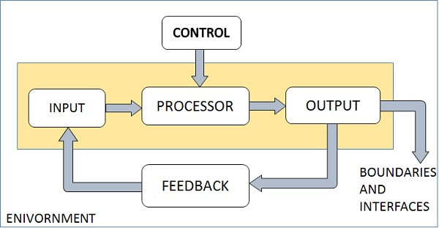
Elements of a System
The following diagram shows the elements of a system −
Outputs and Inputs
The main aim of a system is to produce an output which is useful for its user.
Inputs are the information that enters into the system for processing.
Output is the outcome of processing.

Slide 13
Processor(s)
The processor is the element of a system that involves the actual transformation of input into output.
It is the operational component of a system.
Processors may modify the input either totally or partially, depending on the output specification.
As the output specifications change, so does the processing.
In some cases, input is also modified to enable the processor for handling the transformation.
Control
The control element guides the system.
It is the decision–making subsystem that controls the pattern of activities governing input, processing, and output.
The behavior of a computer System is controlled by the Operating System and software.
In order to keep system in balance, what and how much input is needed is determined by Output Specifications.

Slide 14
Feedback
Feedback provides the control in a dynamic system.
Positive feedback is routine in nature that encourages the performance of the system.
Negative feedback is informational in nature that provides the controller with information for action.
Environment
The environment is the “supersystem” within which an organization operates.
It is the source of external elements that strike on the system.
It determines how a system must function.
For example, vendors and competitors of organization’s environment, may provide constraints that affect the actual performance of the business.

Slide 15
Boundaries and Interface
A system should be defined by its boundaries.
Boundaries are the limits that identify its components, processes, and interrelationship when it interfaces with another system.
Each system has boundaries that determine its sphere of influence and control.
The knowledge of the boundaries of a given system is crucial in determining the nature of its interface with other systems for successful design.

Slide 16
Types of Systems
Open Systems: An open system is the one that interacts freely with the external factors.
These systems are capable of adapting the changes made within the system.
Example: business organizations.
Closed Systems: A closed system is one which is contained within itself.
It does not have any interaction with the environment.
Example: A computer system.

Slide 17
Software Development Life Cycle (SDLC)
Software development life cycle (SDLC) is a structured process that is used to design, develop, and test good-quality software.
SDLC, or software development life cycle, is a methodology that defines the entire procedure of software development step-by-step.
The goal of the SDLC life cycle model is to deliver high-quality, maintainable software that meets the user’s requirements.
SDLC in software engineering models outlines the plan for each stage.
Each stage of the software development model can perform its task efficiently to deliver the software at a low cost within a given time frame that meets users’ requirements.

Slide 18
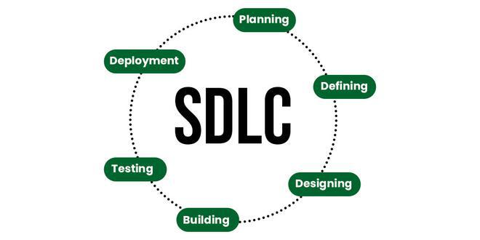
Stages of the Software Development Life Cycle
SDLC specifies the task(s) to be performed at various stages by a software engineer or developer.
It ensures that the end product is able to meet the customer’s expectations and fits within the overall budget.
Hence, it’s vital for a software developer to have prior knowledge of this software development process.
SDLC is a collection of these six stages, and the stages of SDLC are as follows:

Slide 19
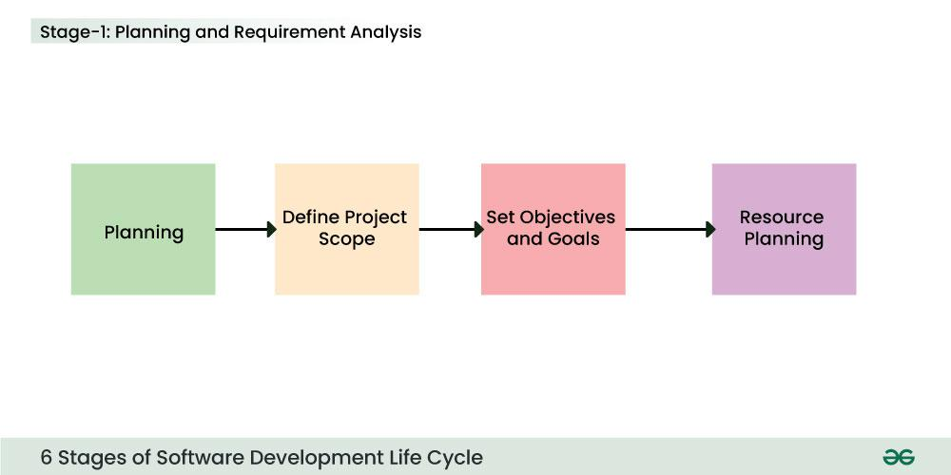
Stage-1: Planning and Requirement Analysis
Planning is a crucial step in everything, just as in software development.
In this same stage, requirement analysis is also performed by the developers of the organization.
This is attained from customer inputs, and sales department/market surveys.
The information from this analysis forms the building blocks of a basic project.
The quality of the project is a result of planning.
Thus, in this stage, the basic project is designed with all the available information.

Slide 20
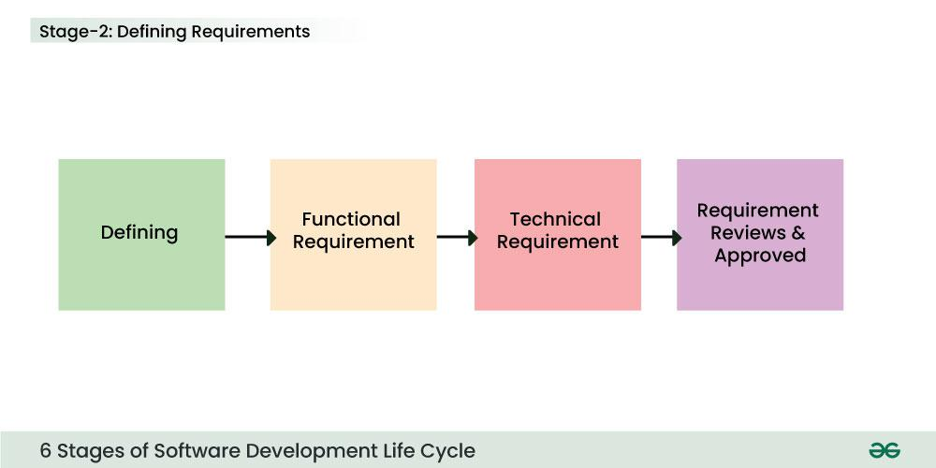
Stage-2: Defining Requirements
In this stage, all the requirements for the target software are specified.
These requirements get approval from customers, market analysts, and stakeholders.
This is fulfilled by utilizing SRS (Software Requirement Specification).
SRS is a sort of document that specifies all those things that need to be defined and created during the entire project cycle.

Slide 21
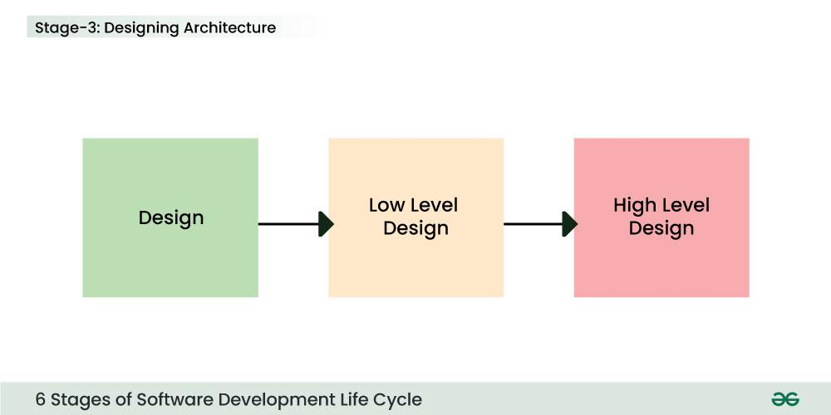
Stage-3: Designing Architecture
SRS is a reference for software designers to come up with the best architecture for the software.
Hence, with the requirements defined in SRS, multiple designs for the product architecture are present in the Design Document Specification (DDS).
This DDS is assessed by market analysts and stakeholders.
After evaluating all the possible factors, the most practical and logical design is chosen for development.

Slide 22
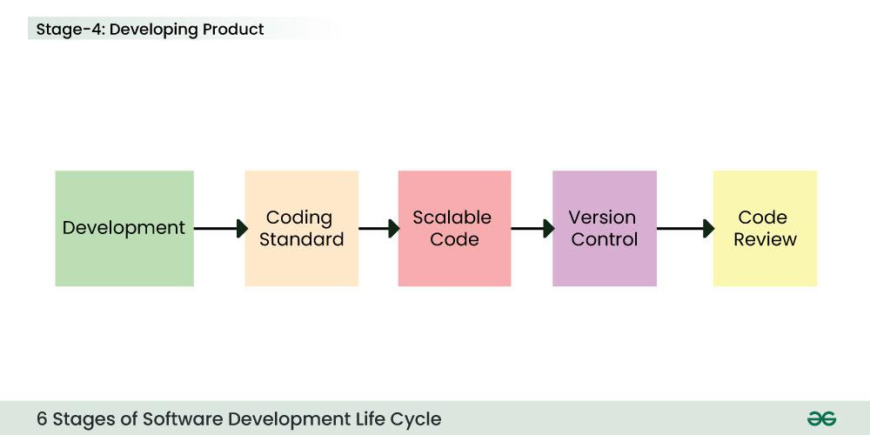
Stage-4: Developing Product
At this stage, the fundamental development of the product starts.
For this, developers use a specific programming code as per the design in the DDS.
Hence, it is important for the coders to follow the protocols set by the association.
Conventional programming tools like compilers, interpreters, debuggers, etc. are also put into use at this stage. Some popular languages like C/C++, Python, Java, etc. are put into use as per the software regulations.

Slide 23
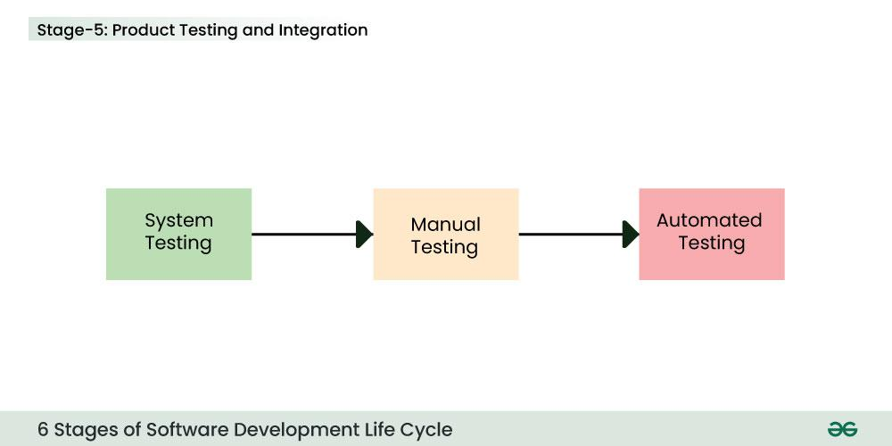
Stage-5: Product Testing and Integration
After the development of the product, testing of the software is necessary to ensure its smooth execution.
Although, minimal testing is conducted at every stage of SDLC.
Therefore, at this stage, all the probable flaws are tracked, fixed, and retested.
This ensures that the product confronts the quality requirements of SRS.

Slide 24
Documentation, Training, and Support: Software documentation is an essential part of the software development life cycle.
A well-written document acts as a tool and means to information repository necessary to know about software processes, functions, and maintenance.
Documentation also provides information about how to use the product.
Training in an attempt to improve the current or future employee performance by increasing an employee’s ability to work through learning, usually by changing his attitude and developing his skills and understanding.

Slide 25
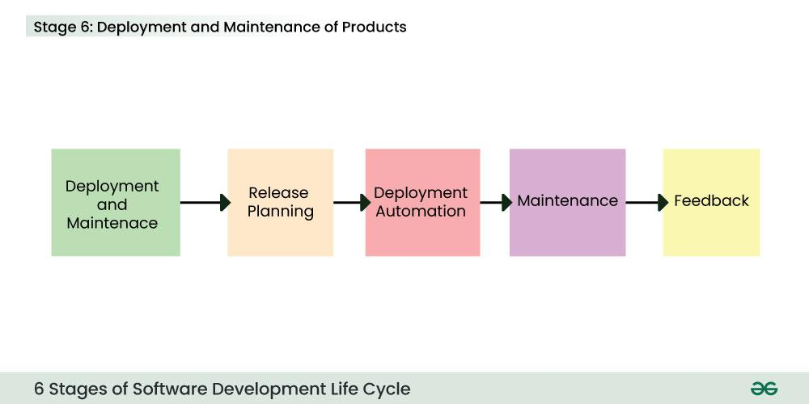
Stage-6: Deployment and Maintenance of Products
After detailed testing, the conclusive product is released in phases as per the organization’s strategy.
Then it is tested in a real industrial environment.
It is important to ensure its smooth performance.
If it performs well, the organization sends out the product as a whole.
After retrieving beneficial feedback, the company releases it as it is or with auxiliary improvements to make it further helpful for the customers.
However, this alone is not enough.
Therefore, along with the deployment, the product’s supervision.

Slide 26
What is the need for SDLC?
SDLC is a method, approach, or process that is followed by a software development organization while developing any software.
SDLC models were introduced to follow a disciplined and systematic method while designing software.
With the software development life cycle, the process of software design is divided into small parts, which makes the problem more understandable and easier to solve.
SDLC comprises a detailed description or step-by-step plan for designing, developing, testing, and maintaining the software.

Slide 27
Waterfall: Best for clear, stable projects with minimal changes.
V-Model: Good for projects with clear requirements and a strong focus on testing.
Agile/Scrum: Ideal for projects with changing requirements and frequent client interaction.
Spiral: Suitable for high-risk projects with evolving requirements.
RAD: Useful for projects needing rapid development.
DevOps: Best for continuous integration and ongoing support

Slide 28
How to Choose an SDLC Model?
Choosing the right SDLC (Software Development Life Cycle) model is essential for project success. Here are the key factors to consider:
Project Requirements:
Clear Requirements: Use Waterfall or V-Model if requirements are well-defined and unlikely to change.
Changing Requirements: Use Agile or Iterative models if requirements are unclear or likely to evolve.
Project Size and Complexity:
Small Projects: Use Waterfall or RAD for small, simple projects.
Large Projects: Use Agile, Spiral, or DevOps for large, complex projects that need flexibility.
Team Expertise:
Experienced Teams: Use Agile or Scrum if the team is familiar with iterative development.
Less Experienced Teams: Use Waterfall or V-Model for teams needing structured guidance.

Slide 29
Client Involvement:
Frequent Client Feedback: Use Agile, Scrum, or RAD if regular client interaction is needed.
Minimal Client Involvement: Use Waterfall or V-Model if client involvement is low after initial planning.
Time and Budget Constraints:
Fixed Time and Budget: Use Waterfall or V-Model if you have strict time and budget limits.
Flexible Time and Budget: Use Agile or Spiral if you can adjust time and budget as needed.
Risk Management:
High-Risk Projects: Use Spiral for projects with significant risks and uncertainties.
Low-Risk Projects: Use Waterfall for projects with minimal risks.

Slide 30
Product Release Timeline:
Quick Release Needed: Use Agile or RAD to deliver products quickly.
Longer Development Time: Use Waterfall or V-Model for projects with no urgent deadlines.
Maintenance and Support:
Long-Term Maintenance: Use Agile or DevOps for projects needing continuous updates and support.
Minimal Maintenance: Use Waterfall or V-Model if little future maintenance is expected.
Stakeholder Expectations:
High Stakeholder Engagement: Use Agile or Scrum if stakeholders want ongoing involvement.
Low Stakeholder Engagement: Use Waterfall or V-Model if stakeholders prefer involvement only at major milestones.

Slide 31
Introduction to System Requests
When organizations want develop or enhance information systems.
, The process often begins with system requests—formal proposals outlining the need for a new system or improvements to an existing one.
A system request typically identifies the business need, expected benefits, and constraints for the system under consideration.
It sets the stage for the feasibility analysis, which evaluates the project’s potential for success from several perspectives: technical, economic, legal, and organizational.

Slide 32
1. System Requests
A system request generally arises from business needs, changes in technology, or opportunities for improvement.
It is the first step in the systems development life cycle (SDLC) and includes key elements such as:
Project Name: A descriptive title for the project.
Project Sponsor: The person or department that initiates the request.
Business Need: The reason the system is being requested, such as addressing inefficiencies or supporting growth.
Business Requirements: High-level descriptions of system functions.
Business Value: Expected benefits from the system, such as cost reduction, increased efficiency, or enhanced customer service.
Special Issues: Any constraints, risks, or dependencies that may affect the project.
Once a system request is submitted, it undergoes feasibility analysis to determine whether the project should proceed.

Slide 33
Feasibility Analysis
A feasibility analysis assesses the viability of a proposed system based on several dimensions.
It helps decision-makers determine whether the project can and should be pursued.
Feasibility study is one of stage among important four stages of Software Project Management Process.
It is a measure of the software product in terms of how much beneficial product development will be for the organization in a practical point of view.
Feasibility study is carried out based on many purposes to analyze whether software product will be right in terms of development, implementation, contribution of project to the organization etc.

Slide 34
1.Technical Feasibility
This aspect assesses whether the organization has the technical resources and expertise to implement the system.
The key factors include:
Technical Skills and Resources: Does the organization have the necessary technology infrastructure and staff expertise?
Technology Compatibility: Will the new system integrate with existing systems and technologies?
Project Complexity: How complex is the project, and what is the likelihood of success given the organization’s technical capacity?

Slide 35
2 Economic Feasibility
Also known as cost-benefit analysis, this dimension evaluates whether the financial benefits of the project outweigh the costs. It includes:
Development Costs: The financial investment required to develop, purchase, or customize the system.
Operational Costs: Ongoing costs such as maintenance, training, and support.
Expected Benefits: Financial savings, increased revenue, or productivity improvements.
Return on Investment (ROI): A comparison of the costs and benefits to determine if the project is financially viable.

Slide 36
3.Legal Feasibility
This analysis examines the legal implications of the project to ensure compliance with laws, regulations, and contractual obligations. It may include:
Regulatory Compliance: Ensuring the system complies with data protection laws, industry standards, and government regulations.
Intellectual Property: Avoiding conflicts with patents, copyrights, and licenses.
Legal Contracts: Ensuring any agreements related to the system’s development or use are lawful.

Slide 37
4 Organizational Feasibility
This dimension assesses whether the proposed system aligns with the organization’s goals, culture, and readiness for change.
It considers:
Organizational Support: Does management and staff support the project? Is there a clear champion for the project?
Cultural Fit: Will the system work well within the existing organizational culture?
Change Management: Can the organization handle the changes the new system will bring, including user training and adaptation?

Slide 38
Introduction to Systems Analyst
A Systems Analyst is a vital role within the Information Technology (IT) team of any organization.
They serve as the bridge between business requirements and technological solutions, ensuring that systems, software, and applications align with business goals.
A Systems Analyst is responsible for analyzing, designing, and implementing information systems that enhance the efficiency and effectiveness of an organization's operations.

Slide 39
Systems Programmer/Analysts
Systems analysts
Research problems, plan solutions, and recommend software and systems.
They work to optimize user experience with programs and advise clients on which software they may need.
Programmers
Write, modify, test, and fix code and scripts that allow computer applications to run.
They often do more coding than other positions.

Slide 40
A systems analyst does more problem research and plans solutions and software and system recommendations to solve these problems.
A programmer analyst works directly with a business or client to determine their unique requirements and then designs and develops a system for them.

Slide 41
Required skills of the systems analyst
Professionals aspiring to become successful Systems Analysts need a skill set that spans technical Knowledge , analytical thinking, and excellent communication.
Here are some key skills essential for the role:
Technical Proficiency: A thorough understanding of database systems, programming languages, and software development methodologies.
Analytical Thinking: Strong analytical skills to dissect business processes and identify areas for improvement or enhancement.
Problem-Solving: Creative problem-solving abilities to devise effective solutions to complex technical issues.

Slide 42
Communication Skills: Excellent verbal and written communication skills to facilitate clear and efficient interaction with both technical and non-technical stakeholders.
Project Management: Proficiency in project management practices to handle multiple tasks, timelines, and resources effectively.
Attention to Detail: An eye for detail to ensure that systems are designed, implemented, and maintained.
Business Awareness: A clear understanding of business operations and the ability to translate requirements into technical solutions.

Slide 43
Responsibilities of the systems analyst
Systems Analysts are entrusted with a variety of responsibilities that make them central to the successful execution of IT projects.
Here are the detailed duties they perform:​
Requirements Gathering: Collaborate with stakeholders to collect and document various business needs and transform them into detailed technical requirements.
System Design: Design system architecture, including databases, interfaces, and business processes, to meet the gathered requirements.
Feasibility Studies: Conduct feasibility analysis to evaluate the proposed system's technical, operational, and financial viability.

Slide 44
Implementation Planning: Develop detailed plans for system implementation, including timelines, resources, and milestones.
Testing and Quality Assurance: Create and execute thorough testing procedures to ensure that systems operate correctly and satisfy all outlined requirements.
User Training: Develop training materials and conduct training sessions to ensure that end-users can effectively utilize the new systems.
​

Slide 45
Support and Maintenance: Provide ongoing support and maintenance for implemented systems, troubleshoot issues, and make necessary adjustments or upgrades.
Documentation: Maintain comprehensive documentation of system specifications, designs, protocols, and user manuals.
Vendor Coordination: Liaise with external vendors to ensure the alignment of third-party software and solutions with organizational needs.

Slide 46
Characteristics of a System Analyst
Knowledge of Organization: –
A system analyst must understand the way in which various organizations function.
The analyst must understand the management structure .
The relationship between the department in an organization as many systems built for making accounting, Financial Management, and supply chain management.
.

Slide 47
2.Knowledge of Computer system and software: –
The system analyst must also know about the recent developments in computer system and software.
3.Good Inter-Personal relations: –
The analyst must be able to interpret user needs must be a good listener and a good diploma.
He/ she must understand people and be able to influence them to change their minds and attitudes.

Slide 48
4.Ability to communicate: –
The analyst is also required to orally present his design to a group of user.
5.Analytical Mind: –
The analyst is required to find a solution to the problem using various analytical tools such as decision tree, decision table etc.

Slide 49
6.Breath Knowledge of a system: –
The analyst has to work with persons performing the various job in an organization such as
an accountant,
salespersons,
clerical staff,
stores officers,
purchase officers,
directors etc.
7.Flexibility and adaptability:-
Different projects.
No matter the same or different organization is of a different nature

Slide 50
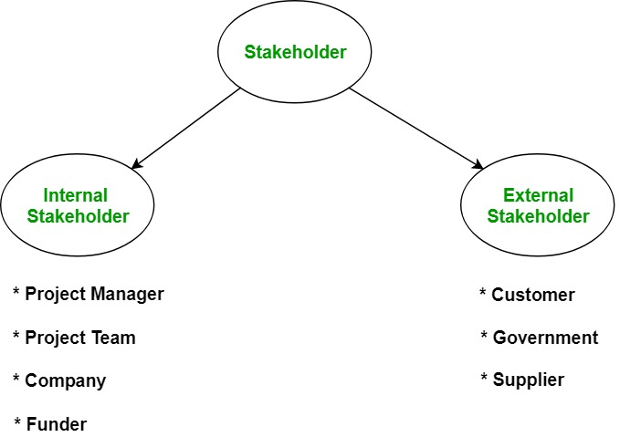
Different Types of Stakeholders

